Slide 1


Using Gaussian copula to generate a synthetic population Yijun Wei NISS, USDA-NASS Yijun.Wei@nass.usda.gov Luca Sartore NISS, USDA-NASS Luca.Sartore@nass.usda.gov Nell Sedransk NISS NSedransk@niss.org
Notes:
Hello everyone, my name is Yijun Wei and I would like to acknowledge my co-auther Luca Sartore and Nell Sedransk

Slide 2
Disclaimer
The Findings and Conclusions in This Preliminary Presentation Have Not Been Formally Disseminated by the U.S. Department of Agriculture and Should Not Be Construed to Represent Any Agency Determination or Policy

Slide 3
Outline
Purpose of research
Census of Agriculture
Gaussian Copula
R package dplyr and ggplot2
dplyr and ggplot2 comparing with base R
dplyr and ggplot2 used for generating synthetic population
Conclusion
Notes:
I will briefly describe the purpose of research, then I am going to introduce Gaussian Copula, and then I will introduce Census of Agriculture, including the definition and how the dataset in this study look like, after that, I will briefly talk about R package dplyr and ggplot2
And compare dplyr and ggplot2 with base R
dplyr and ggplot2 are then used for generating synthetic population step by step
Conclusion will be discussed

Slide 4
National Agricultural Statistics Service (NASS)
Agricultural Estimates
Conducts more than 100 surveys annually
Produces more than 400 reports
Publishes 7 federal principal economic indicators
Provide information for the commodity markets
Tight timelines
Samples are drawn prior to start of growing season
Desire to generate a complex synthetic population
To protect confidential information provided by responders
To maintain pairwise statistical relationships among variables
Notes:
NASS conducts more than 100 surveys, 400 reports, and 7 federal principal economic indicators each year. Samples are drawn prior to start of growing season. NASS would like to spread the response burden to the extent possible, that is the origination of this study.

Slide 5
Purpose of presentation
Generating a complex synthetic population
To protect confidential information provided by responders
To maintain Pairwise statistical relationships among variables
To handle continuous variable and categorical variable simultaneously
Introducing Statistical R packages ggplot2, dplyr that are used for visualization, data processing respectively
Notes:
There are two purposes for this presentation, the first one is to introduce ggplot2, dplyr. Which are vary popular R packages that are used for
Visualization and data processing respectively. the second purpose is to generate a complex synthetic population that Protect confidential information provided by responders
, Maintain Pairwise statistical relationships among variable,
So generating synthetic population is complicated that requires a lot of efforts. To complete, two R packages ggplot2, dplyr

Slide 6
Census of Agriculture
Every five years, USDA's National Agricultural Statistics Service (NASS) conducts the Census of Agriculture
The Census provides a detailed picture of U.S. farms, ranches and the people who operate them
It is the only source of uniform, comprehensive agricultural data for every state and county in the United States
NASS also obtains information on most commodities from administrative sources or surveys of non-farm populations (e.g.\ cotton ginning data)
Notes:
The US Census of Agriculture is conducted by USDA’s National Agriculture Statistics Service (NASS) every five years, in years ending in 2 and 7. The Census provides a detailed picture of the US farms, ranches, and the people who operate them. It is the only source of uniform, comprehensive agricultural data for every state and county in the United States
NASS also obtains information on most commodities from administrative sources or surveys of non-farm populations (e.g.\ cotton ginning data)

Slide 7
Census of Agriculture data overview
A synthetic population is generated for the subset of Census of Agriculture
The subset contains 25 predictors
For example, principal operator’s race, principal operator’s sex, etc…, but they are modified by X1, …, X25
There are both numerical and categorical variables
The total number of observations is 800,000
No missing value

Slide 8
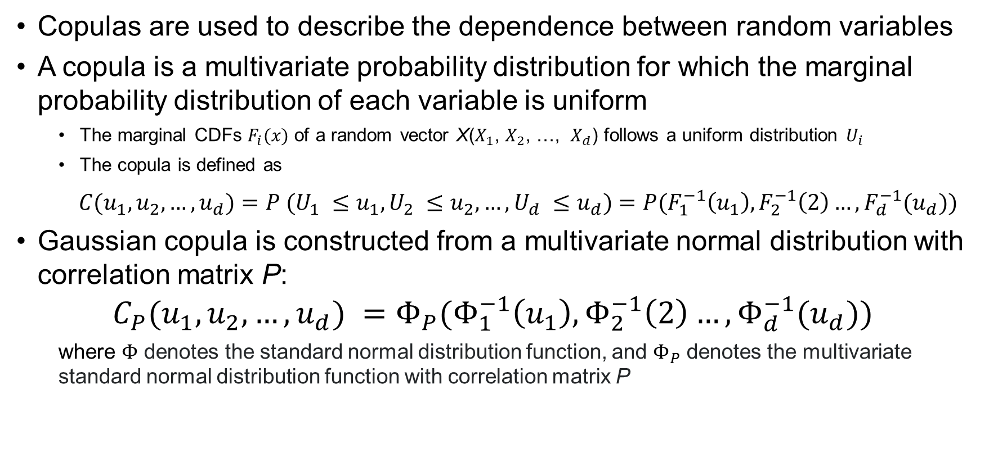
Gaussian Copula
Copulas are used to describe the dependence between random variables
A copula is a multivariate probability distribution for which the marginal probability distribution of each variable is uniform
The marginal CDFs $F_{i}(x)$ of a random vector X($X_{1}$, $X_{2}$, …, $X_{d}$) follows a uniform distribution $U_{i}$
The copula is defined as
${C(u}_{1},u_{2}, …,u_{d})=P ({U_{1} ≤u}_{1}, {U_{2} ≤u}_{2}, …,U_{d} ≤u_{d})$ $=$ $P(F_{1}^{−1}\left(u_{1}\right),F_{2}^{−1}\left(2\right)…,F_{d}^{−1}(u_{d}))$
Gaussian copula is constructed from a multivariate normal distribution with correlation matrix P:
$${C_{P}(u}_{1},u_{2}, …,u_{d}) =Φ_{P}(Φ_{1}^{−1}\left(u_{1}\right),Φ_{2}^{−1}\left(2\right)…,Φ_{d}^{−1}(u_{d}))$$
where $Φ$ denotes the standard normal distribution function, and $Φ_{P}$ denotes the multivariate standard normal distribution function with correlation matrix P
Notes:
After looking at two R functions, let us turn to using those two R functions for generating synthetic population using Gaussian copula in census of agriculture.
Copulas are used to describe the dependence between random variables, A copula is a multivariate probability distribution for which the marginal probability distribution of each variable is uniform. CDF of any variable is definitely uniformly distributed.
The Gauss copula is defined implicitely from the multivariate normal distribution, that is, the Gauss copula is the copula associated with a multivariate normal distribution. Gaussian copula is constructed from a multivariate normal distribution with correlation matrix P

Slide 9
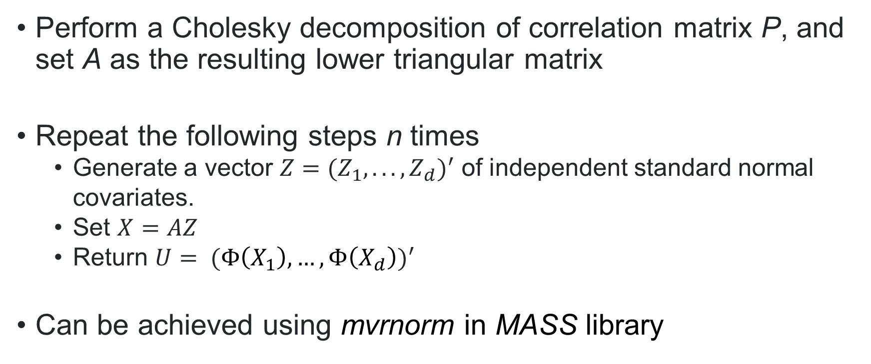
Gaussian Copula applied in generating synthetic population
Perform a Cholesky decomposition of correlation matrix P, and set A as the resulting lower triangular matrix
Repeat the following steps n times
Generate a vector $Z={(Z_{1}, .. ., Z_{d})}^{′}$ of independent standard normal covariates.
Set $X=AZ$
Return $U= {(Φ\left(X_{1}\right),…,Φ\left(X_{d}\right))}^{′}$
Can be achieved using mvrnorm in MASS library
Notes:
Gaussian Copula can be applied in generating synthetic population while keeping their pairwise correlations between different variables. The first step is to Perform a Cholesky decomposition of correlation matrix P, and set A as the resulting lower triangular matrix. Repeat the following steps n times. But we do not have to do all these from the scratch, this can be achieved by using mvrnorm in MASS library
So generating synthetic population is complicated that requires a lot of efforts. To complete, two R packages ggplot2, dplyr

Slide 10
R packages Introduction
A Grammar of Data Manipulation (dplyr)
R-package used for data processing
Transform and summarize tabular data with rows and columns.
Contain a set of functions (or “verbs”) that perform common data manipulation operations
Create Elegant Data Visualisations Using the Grammar of Graphics (ggplot2)
R-package used for data visualization
Consistent underlying grammar of graphis (a graphic version of dplyr)
Plot specification at a high level of abstraction
Very flexible and elegant
Notes:
Two packages are going to be introduced, Dplyr and ggplot2. Dplyr is mainly used for data processing and ggplot2 is mainly used for data visualization. dplyr is a powerful R-package to transform and summarize tabular data with rows and columns, contains a set of functions (or “verbs”) that perform common data manipulation operations such as filtering for rows, selecting specific columns, re-ordering rows, adding new columns and summarizing data. Create Elegant Data Visualisations Using the Grammar of Graphics (ggplot2)
R-package used for data visualization
ggplot2 is the graphic version of dplyr
consistent underlying grammar of graphis
plot specification at a high level of abstraction
very flexible and elegant
A subset of the Census of Agriculture dataset are used to evaluate dplyr and ggplot2

Slide 11
R packages Introduction - dplyr
Commonly used command:
mutate() adds new variables that are functions of existing variables
select() picks variables based on their names
filter() picks cases based on their values
summarise() reduces multiple values down to a single summary
arrange() changes the ordering of the rows
group_by() allows for group operations in the “split-apply-combine” concept
Notes:
mutate() adds new variables that are functions of existing variables
select() picks variables based on their names.
filter() picks cases based on their values.
summarise() reduces multiple values down to a single summary.
arrange() changes the ordering of the rows.
summarise() summarise values
group_by() allows for group operations in the “split-apply-combine” concept

Slide 12

R packages Introduction – dplyr - Continue
Base R:
Create new dataset:
Select Variable:
Filter variable:
Sort by variable value:
Notes:
Usually, in base R, if you would like to perform multiple tasks, you have to write many lines of code to complete. I am taking a subset of census dataset for example, if you would like to create several new variables, you have to do that one by one in the base R. as in the example, you have to write 4 lines of code to perform what you want. And you have to write one more line of code to select variable, and one more line to filter variable, and one more line to sort the variable. It is either too many codes you have to write or it is difficult to understand if you are reading program written by someone else.
Just think about if you would like to create 100 variables and filter based on some cretirias, it would be a disaster either for you to write or to read.

Slide 13
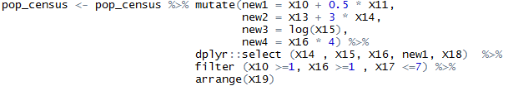
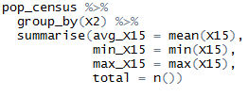
R packages Introduction – dplyr - Continue
dplyr
This can be done with one function using dplyr:
Notes:
However, in dplyr R package, you can finish different tasks just in one function, for example, you are creating new1, new2, new3, new4, and select a subset of x14, x15, x16, new ,and x18, filtering and sorting om x19 simultaneously, what a simple and elegant function here. In addition, u can create mean, maximum, minimum, and total by group. This is also 10s of lines of code in base R

Slide 14
R packages Introduction – ggplot2
Graphic version of dplyr (using ‘+’ to replace ‘%>%’)
Building blocks of a graph include:
data
aesthetic mapping
geometric object
statistical transformations
scales
coordinate system
position adjustments
faceting
Notes:
Ggplot 2 is a graphic version of dplyr ( using plus to replace the pipe %>%)
The basic idea: independently specify plot building blocks and combine them to create just about any kind of graphical display you want. Building blocks of a graph include:data
aesthetic mapping
geometric object
statistical transformations
scales
coordinate system
position adjustments
Faceting. I am showing an example related to census of agr data in the following slides.

Slide 15
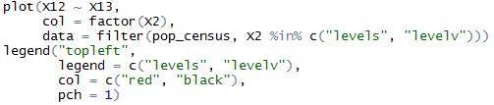
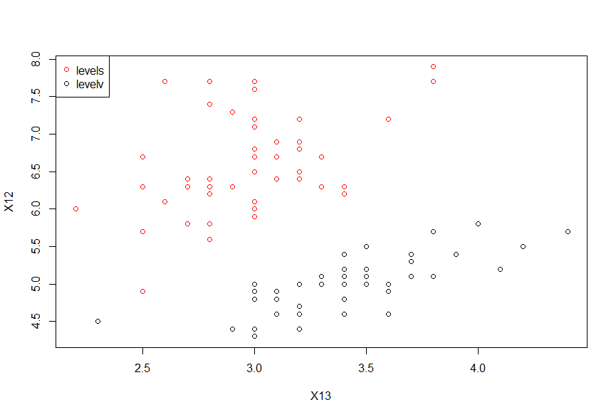
R packages Introduction – ggplot2 - Continue
base R
Notes:
This plot is generated by base R. it’s ok, but if you are looking at a graph like this, u will be ummm…. May be changes are needed.
you have to write two different functions to do that

Slide 16

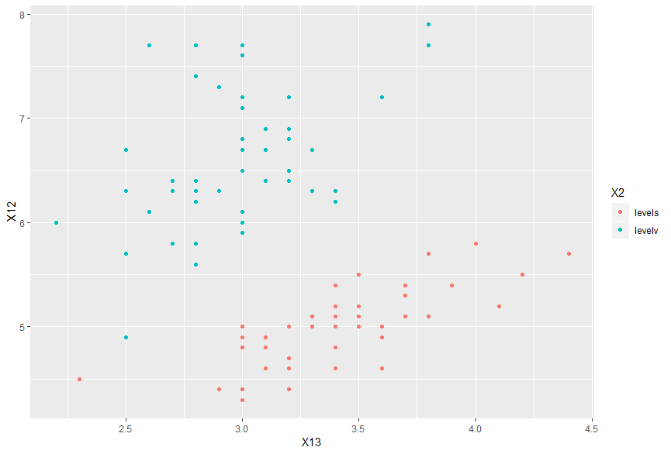
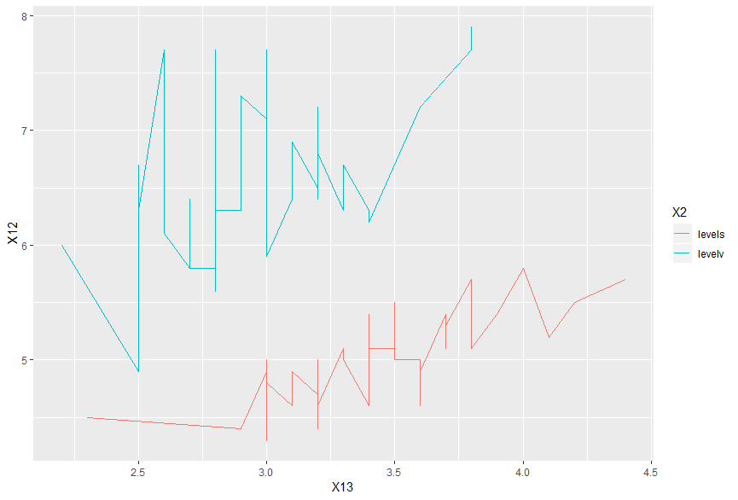
R packages Introduction – dplyr - Continue
ggplot2
Notes:
This is the same thing achived by ggplot2, u can find there is a big improvement, the background is not only a black plane. The dot is well presented. The legend lies apart from the graph instead of lying in the graph. Additionally, u can add things pretty quick by adding a “plus” sign and the object, for example, the right graph is just changing the geom_point to geom_line. You can change to anything you like, to histogram, etc…

Slide 17
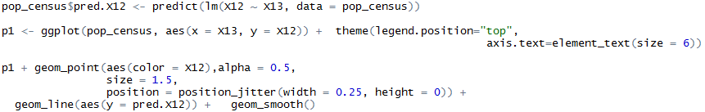
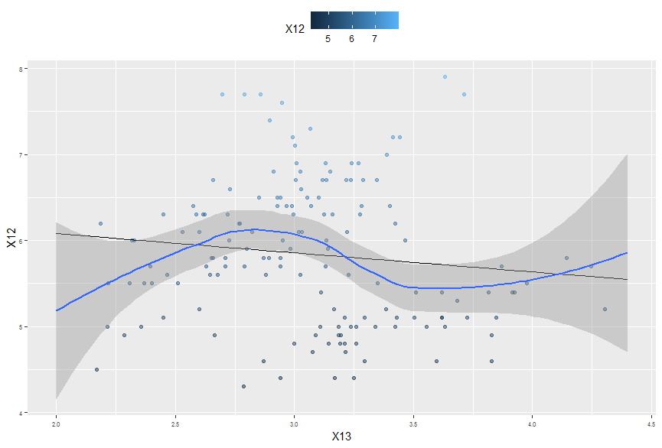
R packages Introduction – ggplot2 - Continue
More advanced features
Notes:
More features can be achieved by using ggplot2, just adding objects using ‘plus’ sign.
For the example I am showing here, you can add regression lines and smooth function, you also can move the place of the legend, you can change the size and color of the points based on its value,
You can also change the background

Slide 18



Step by Step R function
Categorical covariates are converted to continuous before using copula
The frequency of the categorical covariate’s levels is used as the value for that level
CDF of the covariate are transformed to be used in copula
$U_{i}$ is transformed to $Φ_{i}^{−1}\left(u_{i}\right)$ using ecdf and qnorm
Notes:
The reason why I am using apply here is: Although it is super efficient, using apply sometims is difficult to understand, especially if you are reading other’s program. For example, here

Slide 19
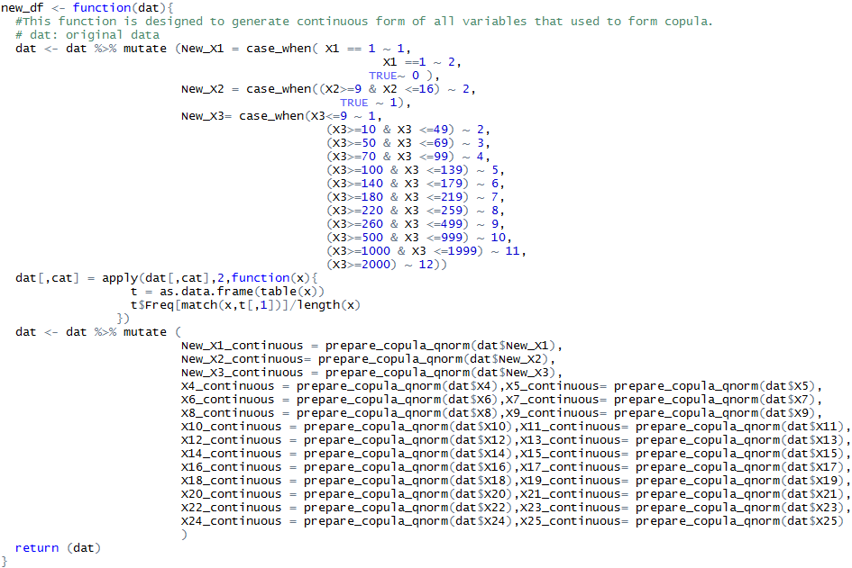
Step by Step R function - Continue
Notes:
New_x1, new_x2, new_x3 are created using mutate, case_when is used to create different groups case by case. Then categorical variables are converted to continuous variables.
Then cdfs are transformed by the function I defined before.

Slide 20
Step by Step R function - Continue
Notes:
New_x1, new_x2, new_x3 are created using mutate, case_when is used to create different groups case by case. Then categorical variables are converted to continuous variables.
Then cdfs are transformed by the function I defined before.

Slide 21
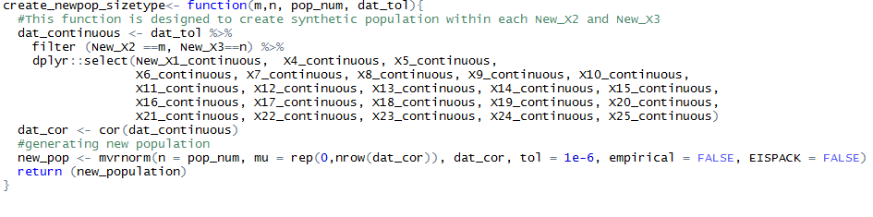
Step by Step R function - Continue
Notes:
We can find that using dplyr makes everything very simple. You can achieve 10s or hundreds of code that base R used by only a few functions. The program is also very readable.
This function is used to generate new population based on each categories of newX2 and newX3.

Slide 22
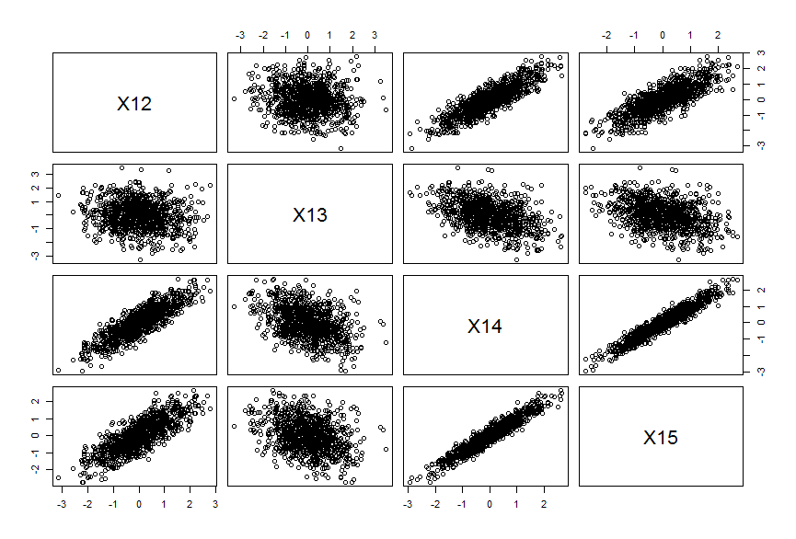
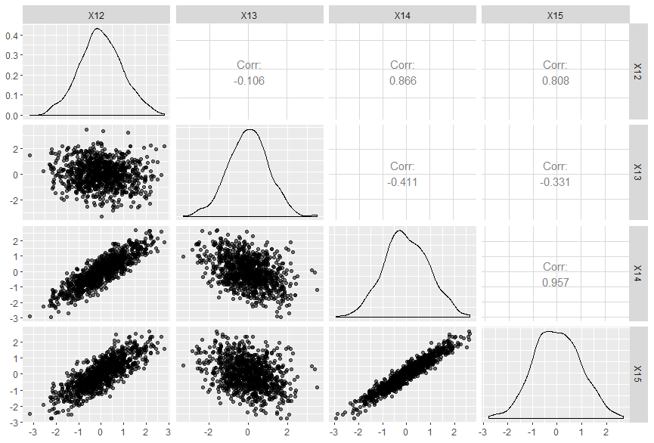
Pairwise correlation comparison

Slide 23
Summary
This study
Comparing two R packages dplyr and ggplot2 with base R for descriptive analysis
Displaying additional function can be achieved by dplyr and ggplot2
Generating synthetic population using dyplyr and base R
Visualizing the correlation using ggplot2
Dplyr and ggplot2 are two useful R packages comparing with base R
More convenient to manage
Easy to read
Decrease the workload

Slide 24
References
Nelsen, R. B. (2007). An introduction to copulas. Springer Science & Business Media.
Wickham, H., Francois, R., Henry, L., & Müller, K. (2015). dplyr: A grammar of data manipulation. R package version 0.4, 3.
Wickham, H. (2016). ggplot2: elegant graphics for data analysis. Springer.

Slide 25
Any Questions?
Thank you!

